Slide 1
BST: Red Black Tree
Theory and Practice

Slide 2
High Level Overview
Binary Search (Balanced) Trees

Slide 3
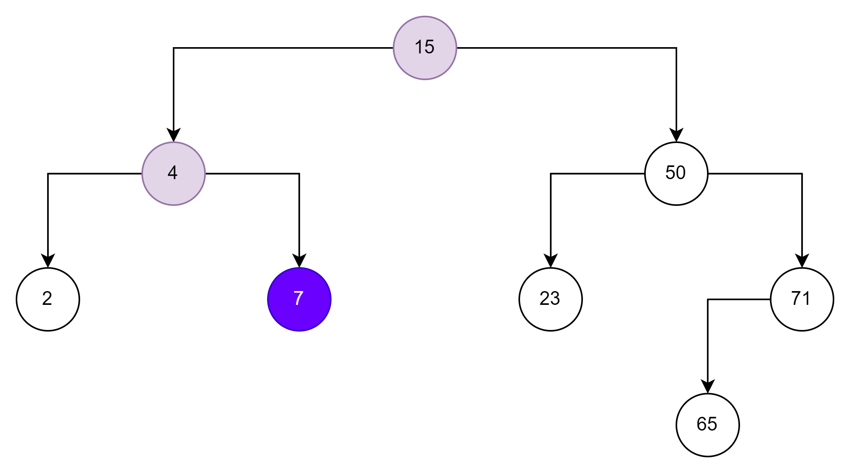


Binary Balanced Tree
Operation | Complexity
Search | O(log(N))
Insert | O(log(N))
Find Max/Min | O(log(N))
Remove | O(log(N))
Organization as a tree implements divide and conquer strategy

Slide 4
Binary Balanced Tree Implementations
Red-Black Tree (RB).
Adelson-Velskii Landis (AVL).
Usually RB is used for implementations:
C++: std::set, std::map.
Java: TreeSet, TreeMap.
C#: SortedSet, SortedMap.
There is an analog of upper_bound in C# as well!

Slide 5
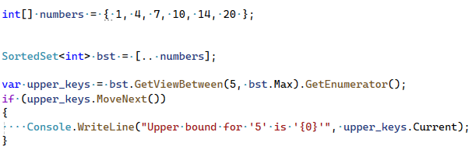
Upper Bound and Lower Bound in C#
Let's assume we have array [1, 4, 7, 10, 14, 20]
Link to documentation: .NET 9 documentation
Link to .NET9 Source Code: Link to GitHub

Slide 6
Red Black Tree Theory

Slide 7
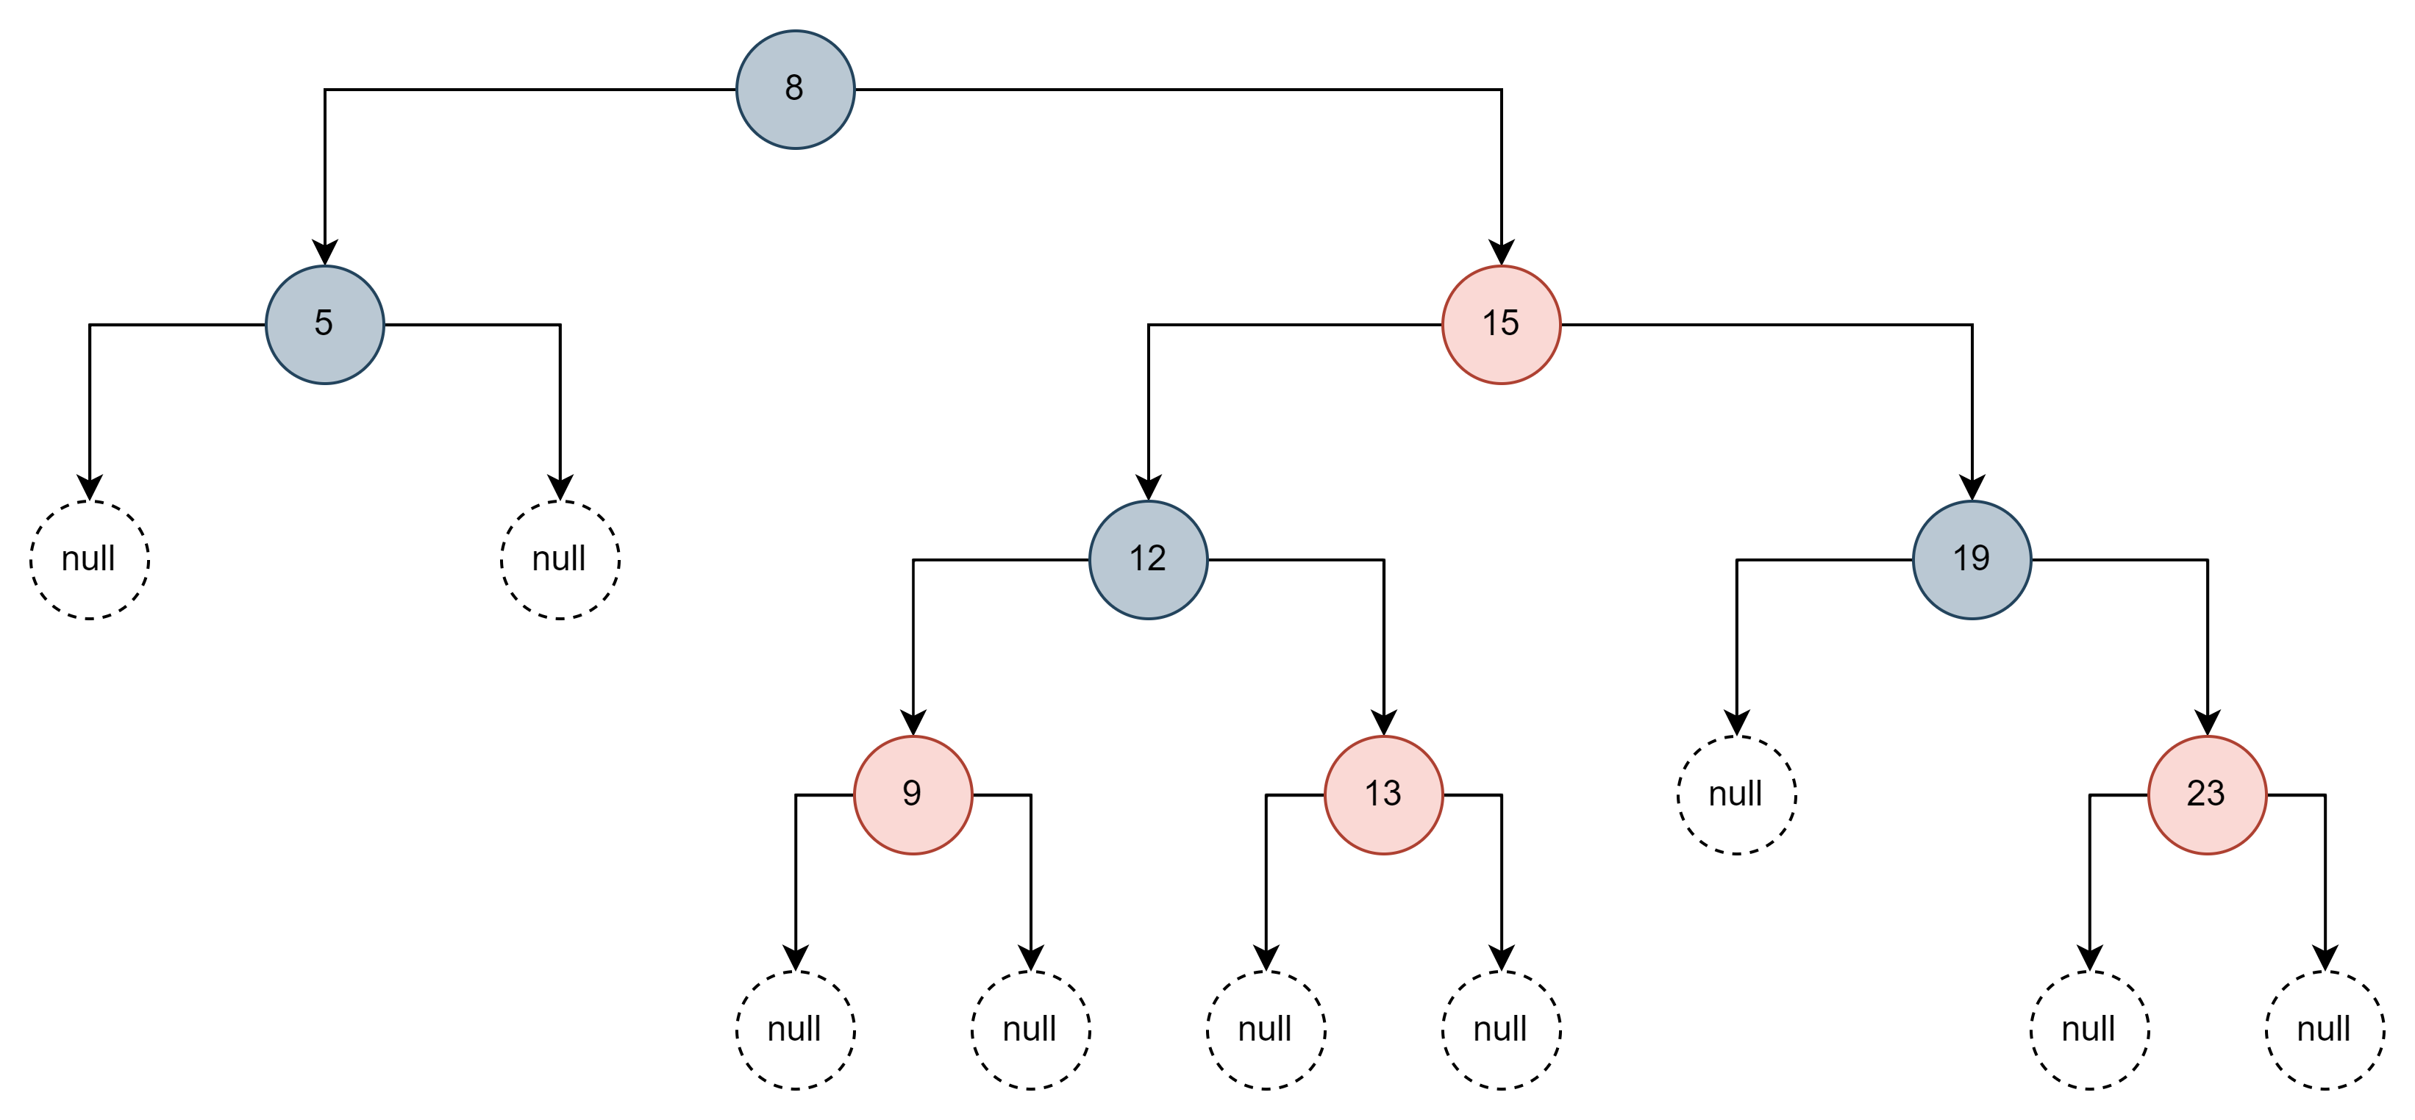
How Red-Black Tree Works
Uses color to detect conflicts and used as an indicator for rebalancing.

Slide 8
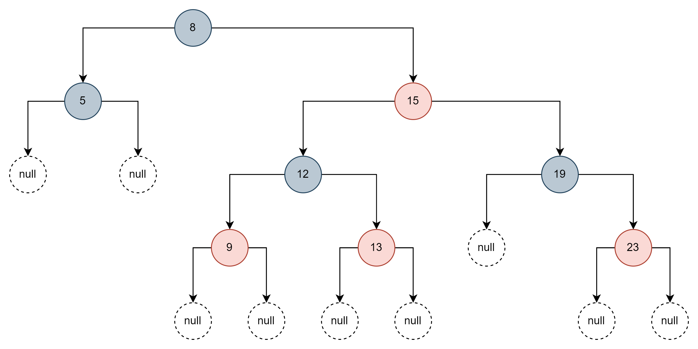
Red-Black Tree Rules
A node is black or red.
The root and leaves are black.
If a node is red, then its children are black.
All paths from a node have the same number of black nodes.
No such path that is more than twice as long as any other.
The longest branch: 2log₂(N + 1)

Slide 9





Balanced Tree Appearance
All paths from node to its NULL (leafs) contain the same number of black nodes.
Height here is 2

Slide 10
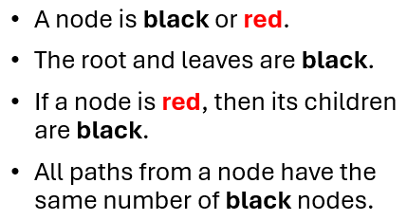

How to Insert Node
Insert node and mark it red.
Recolor and rotate nodes to fix violations.
The node is marked as red to potentially break rules of the tree and force rebalancing.

Slide 11
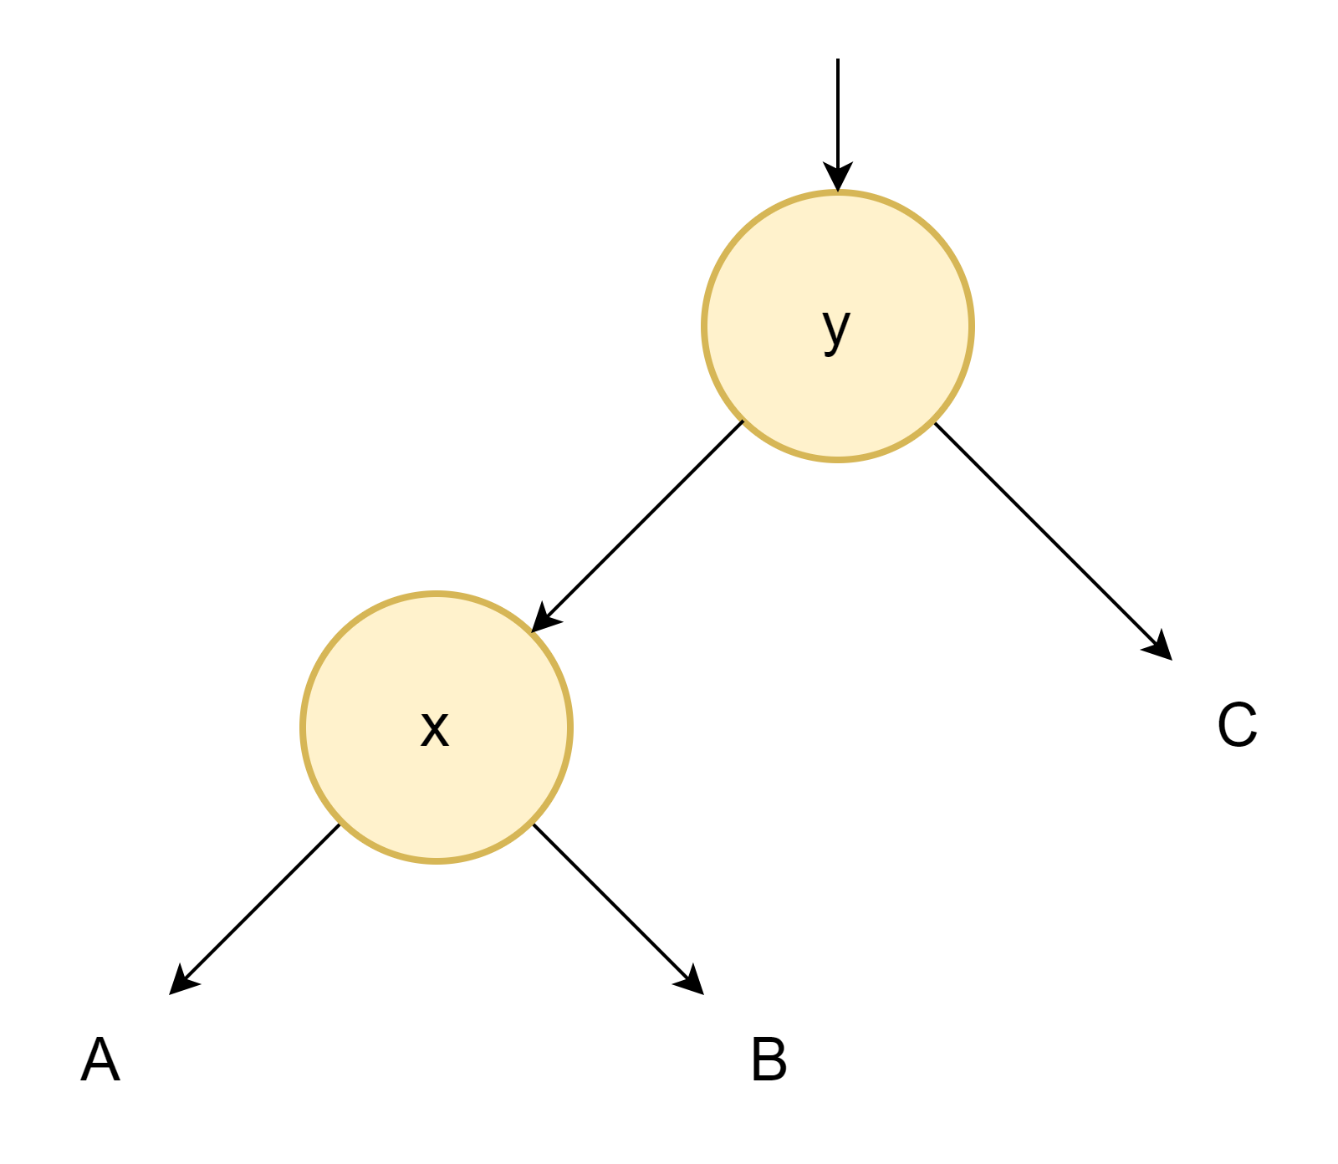
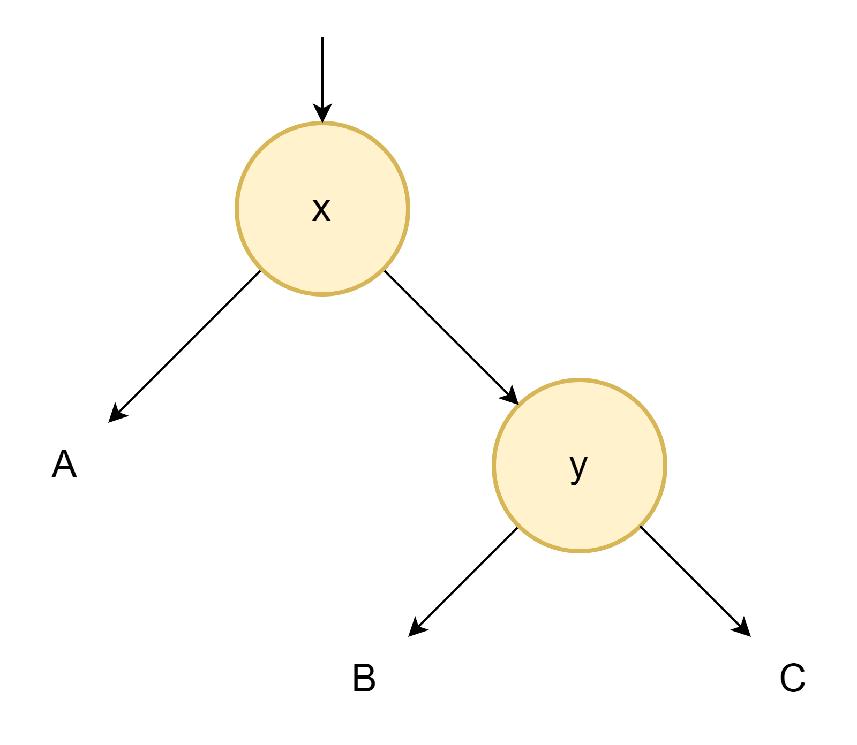
What is Rotation in a Tree
We need a building block before we continue:
What is the rotation and how it works?
Left Rotate
Right Rotate

Slide 12
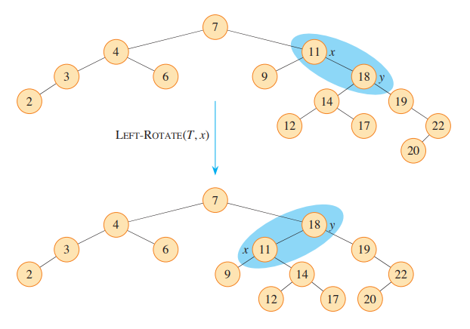
Rotation Illustration
Example from the book ‘Introduction to Algorithms’.

Slide 13
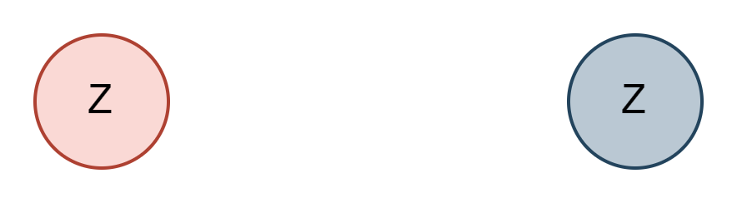
Four Insertion Cases – Case 1
Case 1: Z is Root.
Solution: Change Color

Slide 14
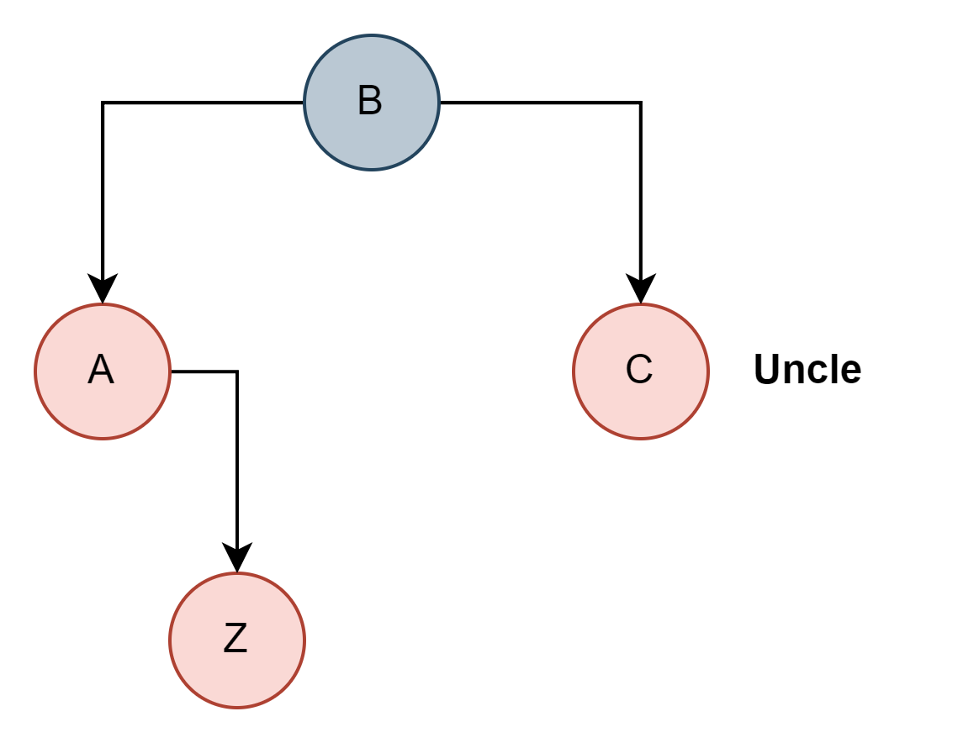
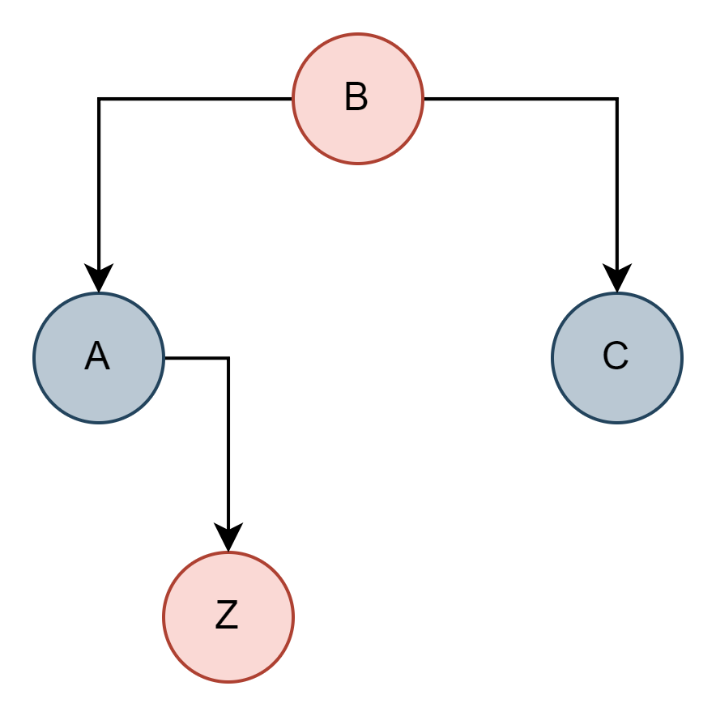




Four Insertion Cases – Case 2
Case 2: Z.Uncle == Red
Solution: Recolor grandparent, parent and uncle.

Slide 15
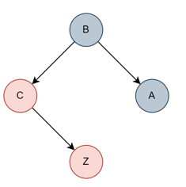
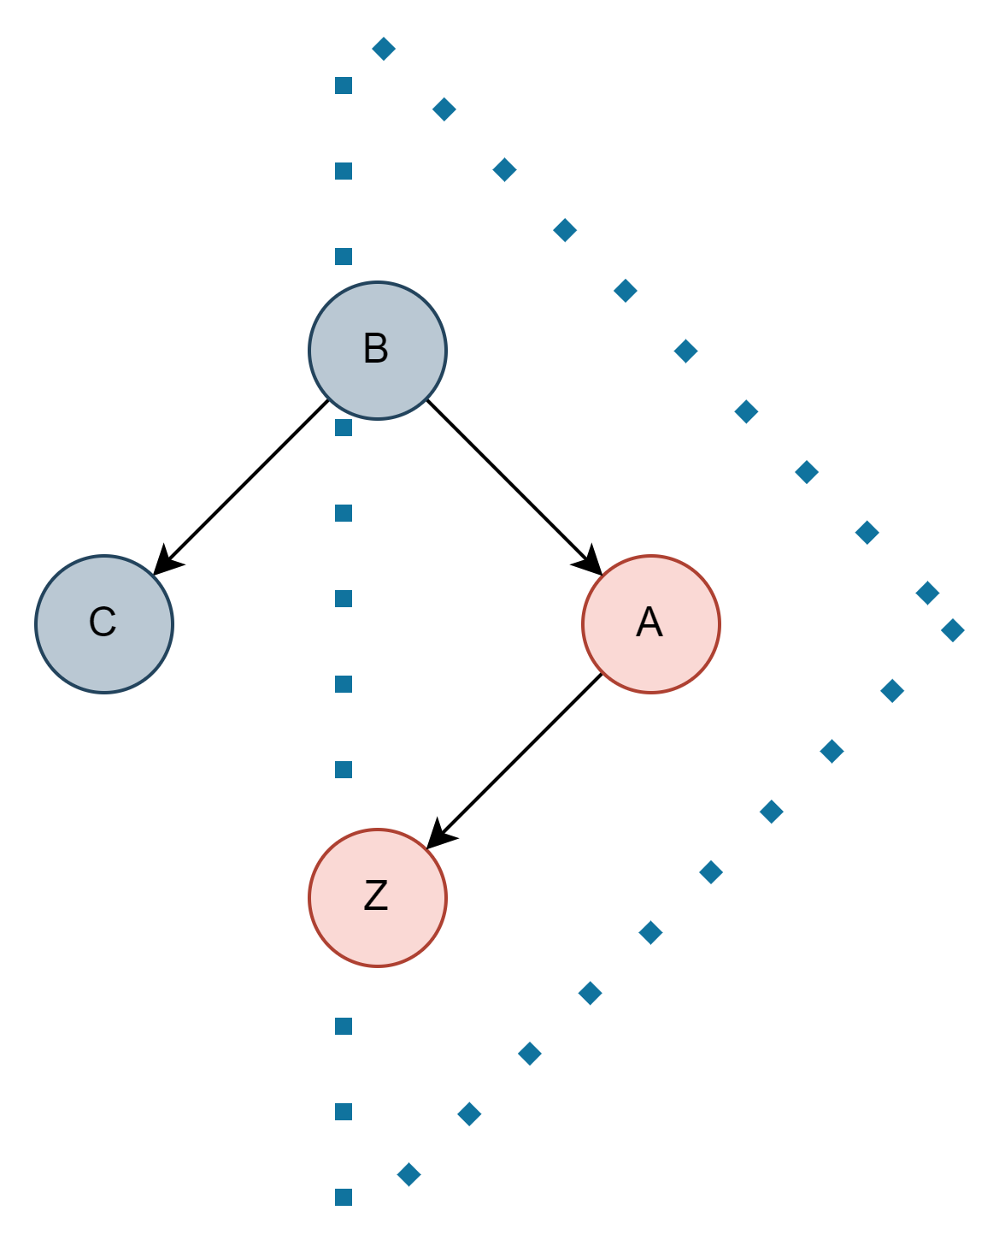
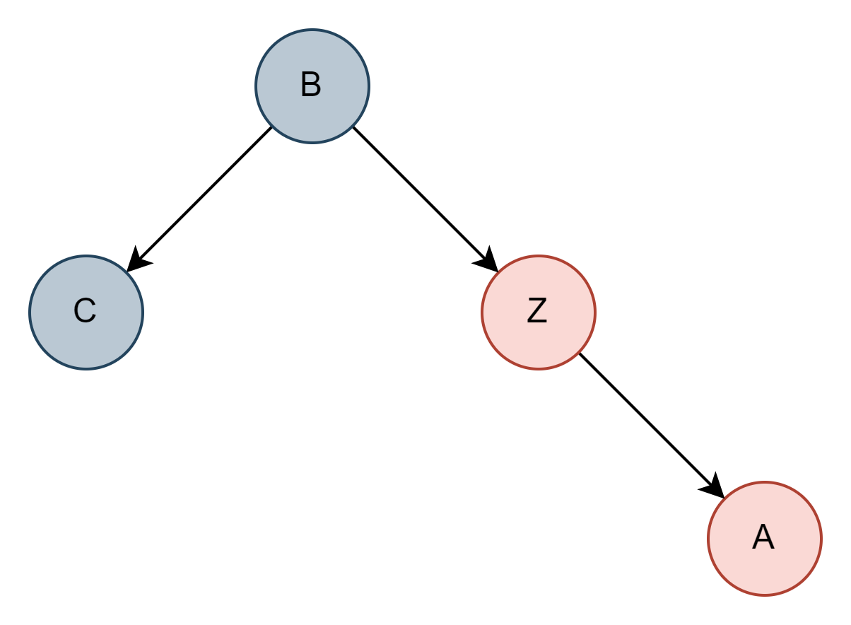




Four Insertion Cases – Case 3
Case 3: Z.Uncle == Black (triangle)
Solution: Rotate Z.parent.
The same case, just symmetrical.

Slide 16
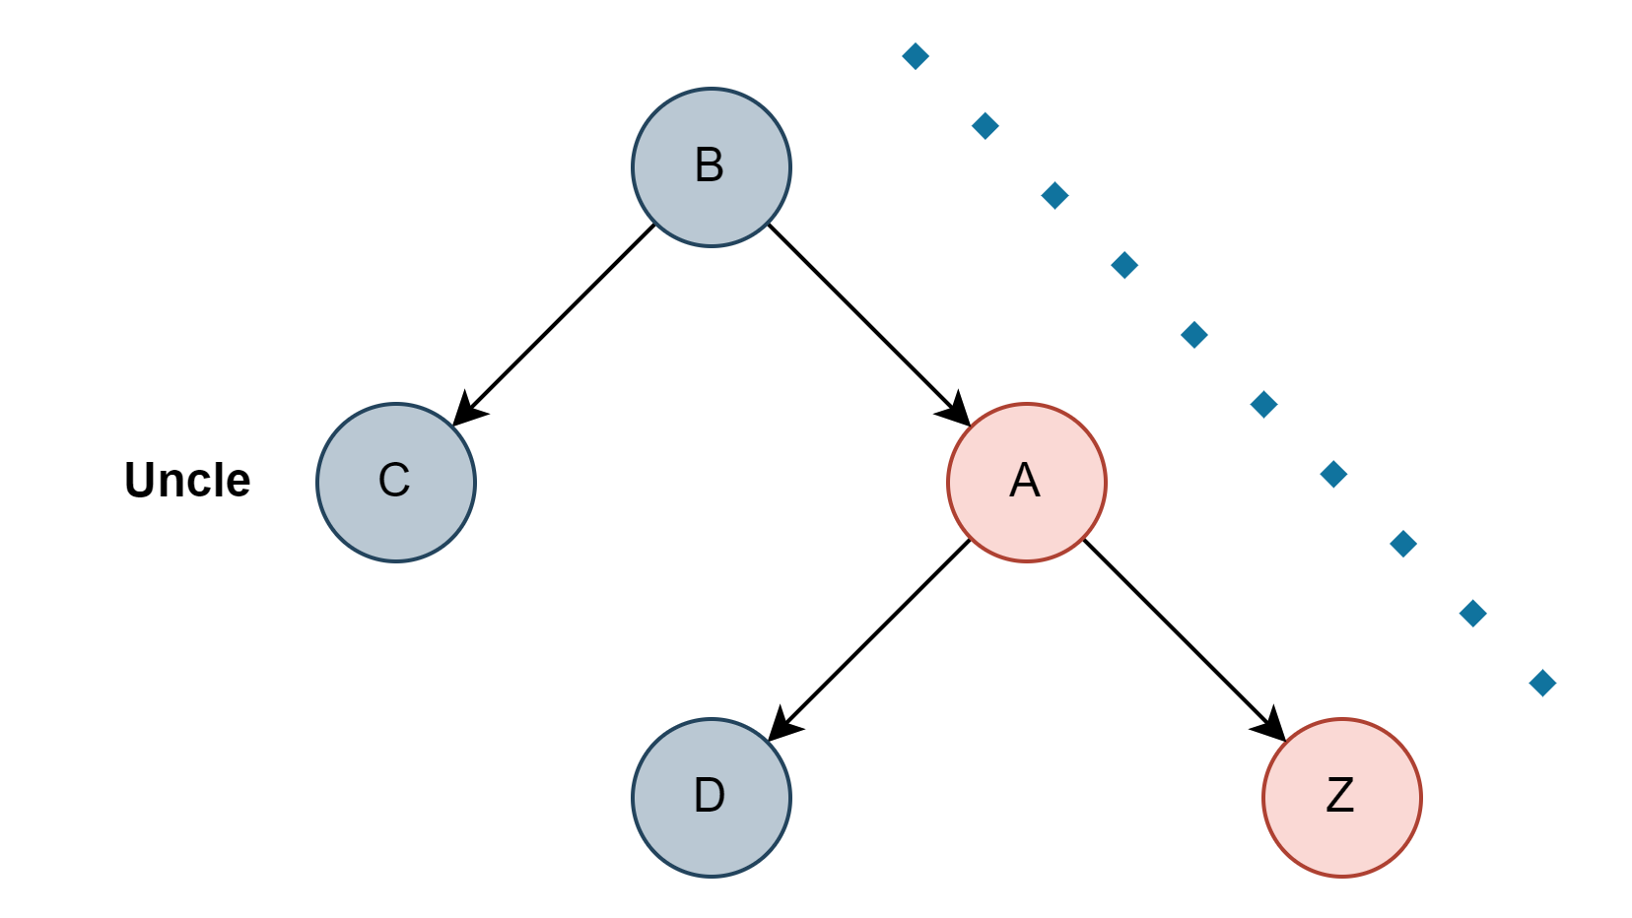
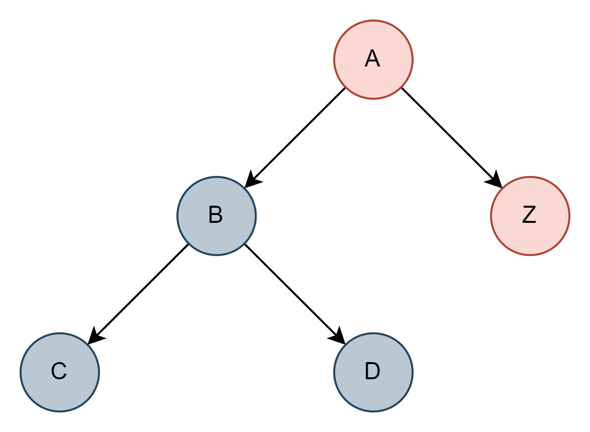
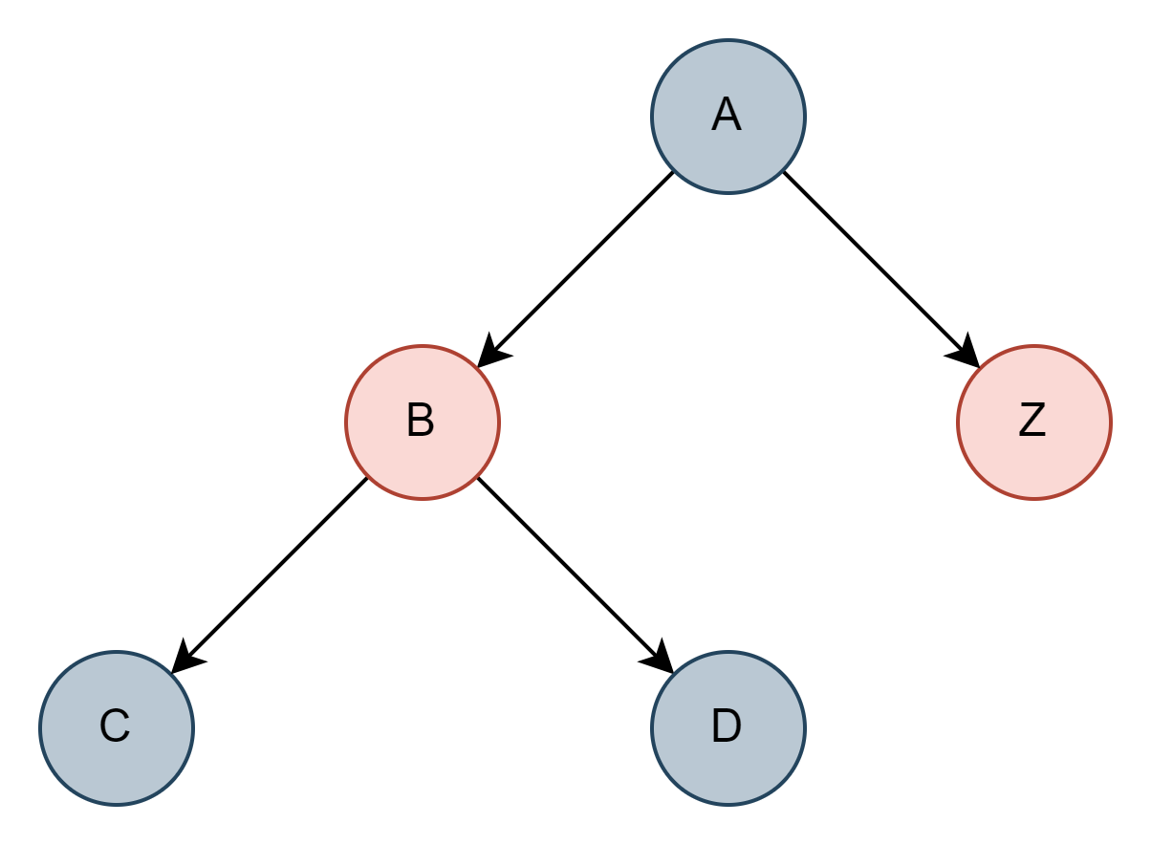

Four Insertion Cases – Case 4
Case 4: Z.Uncle == Black (Line).
Solution: Rotate Z.grandparent and recolor original parent and grandparent.

Slide 17
Four Cases – Summary
Z == root => color black.
Z.uncle == red => recolor.
Z.uncle == black (triangle) => rotate Z.parent.
Z.uncle == black (line) => rotate Z.gradeparent and recolor.

Slide 18
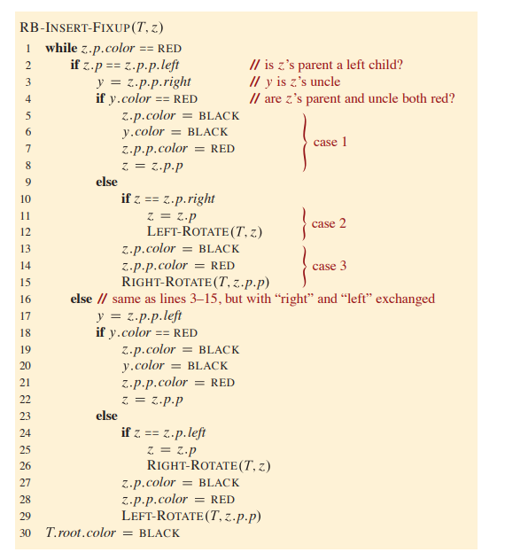
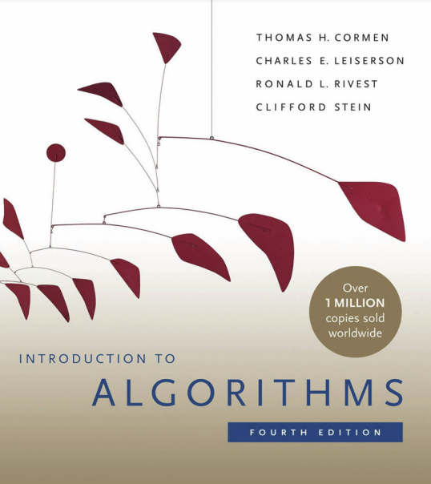
Four Insertion Cases – Pseudocode
From book “Introduction to Algorithms – Cormen – 4th Edition”.

Slide 19
Practice
Binary Search (Balanced) Tree

Slide 20


Use-Cases for BST
To have sorted collection – priority queue.
To find upper bound for a value.
To find a value.
To find minimum and maximum.
To have unique values.
Intersection with Hash Tables

Slide 21
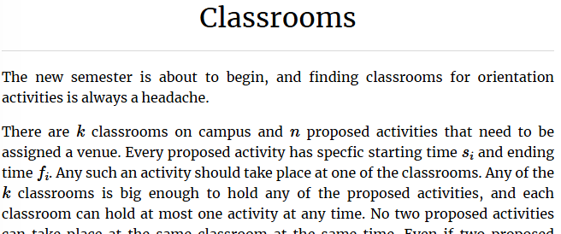
Practice – Upper or Lower Bound
Let’s take a look at the task that were solved before: Link

Slide 22
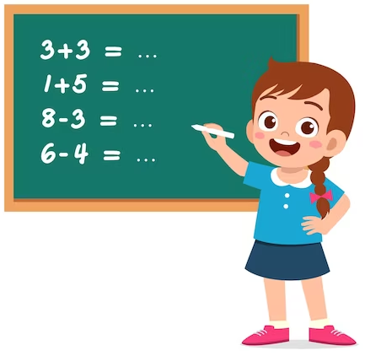
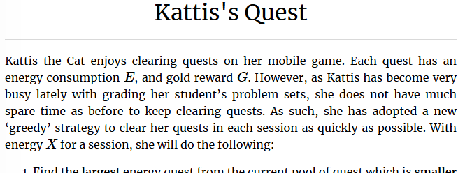
Practice – Kattis’s Quest
Link: Link to the Problem

